Slide 1

Facebook vs. Predicting Check ins
Team 1: Gio DeFrank, Ashley Chiasson, Justin Pearson, Jingyi Wang

Slide 2

Overview of Competition:
The goal of this competition is to predict check-in locations for individuals on a virtual platform.
Facebook simulated a dataset, consisting of:
An artificial world consisting of more than 100,000 locations (place_id’s), each located in a 10 km x 10 km grid
30 million (simulated) check-ins on the grid
columns : place_id, X, Y, Time, Accuracy
The task at hand is to predict the most likely locations that an individual will check in at.
Notes:
Data is created to resemble location signals coming from mobile devices, giving the competitors a sense of working with real-world data complicated by large amounts of noise and inaccuracy

Slide 3
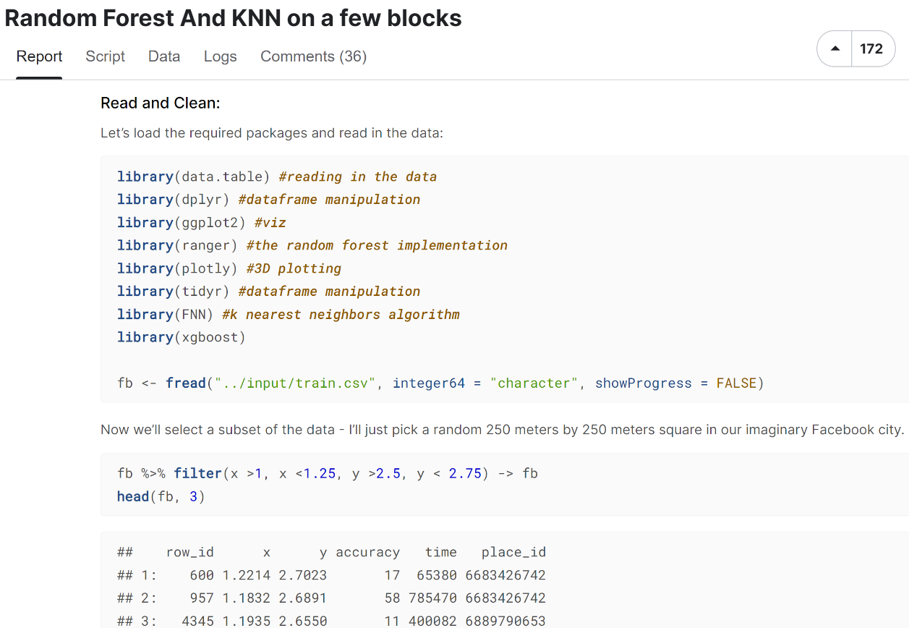
Notebook 1: “Random Forest and KNN on a few blocks”
250x250 m block
No distinguishable X/Y pattern
Fit a scaled KNN model to the dataset
Accuracy rate of about 51%
Random Forest model (using the Ranger package)
Returns almost 55% accuracy rate
Performs better on the more popular sites
Notes:
Important to note that the random forest model not only performed better on the more popular sites, but also performed worse on the more sparsely visited sites

Slide 4
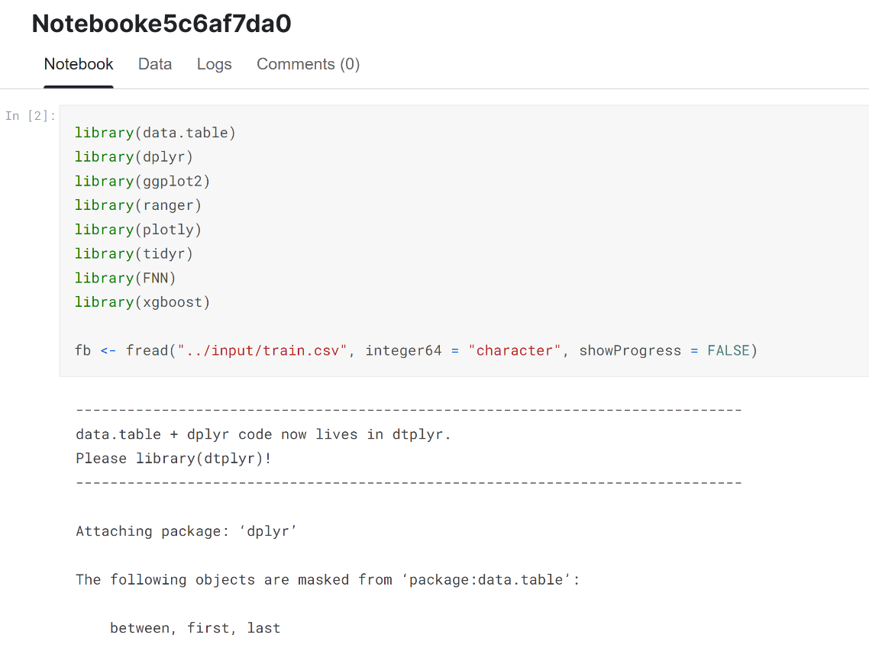
Notebook 2: “Notebooke5c6af7da0”
Essentially the same code as the entry above
Differences
K increased from 15 to 20
Num_trees = decreased from 100 to 20
Other Entries:
Variety of errors
Notes:
Datatype errors and syntax-based errors very common in the other, lower scoring entries

Slide 5
Overarching Critiques:
Lack of commented code
Most entries used methods that we are not familiar with
This competition took place 6 years ago, so they are likely outdated
R language has been updated from v. 3.0.0. To 4.1.0 (at least) since 2016
Cross validation was not conducted on either the KNN or RandomForest models
Different trees/clusters were not tested with different amounts/densities
Notes:
Most of the entries in this competition were difficult to follow as they did not comment their code. If a technique was used that we were unfamiliar with, it was nearly impossible to to decipher what was going on in the script. It is also important to note that this competition did take place 6 years ago and R language has been updated significantly since 2016. With this being said, some of the methods used in this competition may be obsolete or the syntax may have been tweaked in updates, which could be a possible explanation for the high frequency of error-filled code. Both models that we selected for critique did not perform cross-validation on either of their models, which is something we certainly wanted to improve upon in our models. Lastly, the models we critiqued did not appear to have tested different cluster or tree sizes. After reviewing a handful of entries into the competition, we were able to formulate our own plan to produce better models.

Slide 6
Our Plan:
Take inspiration from models we critiqued
Use tuning methods from class to find models that produce the best results
Use a smaller sample of the dataset, for time efficiency
Test dataset had almost 9 million rows, so we decided to subset that into a training and testing group
Notes:
For our plan, we obviously wanted to base our models on the same framework as the ones we critiqued. We thought that if we changed too much, we wouldn’t have been able to tell if we made any improvements. With this in mind, we decided to use tuning methods that we learned in class to find the most optimal models. Another important change we made was using a slightly smaller sample of the dataset. The original test dataset was quite large, and took a few minutes to load in, so we decided, for time’s sake, to use smaller sample.

Slide 7
Why choose KNN, RandomForest
SVM:
Pros
High dimensional
Non-linear kernel
Cons
require a lot of time for training a large number of training example
Hard to interpret
Can not get probabilities directly
KNN:
No training period
RandomForest:
High dimensional
Larger number of training example
Categorical features
Notes:
Logistic regression: 2 classes

Slide 8
We will now demonstrate our model in R.

